Slide 1

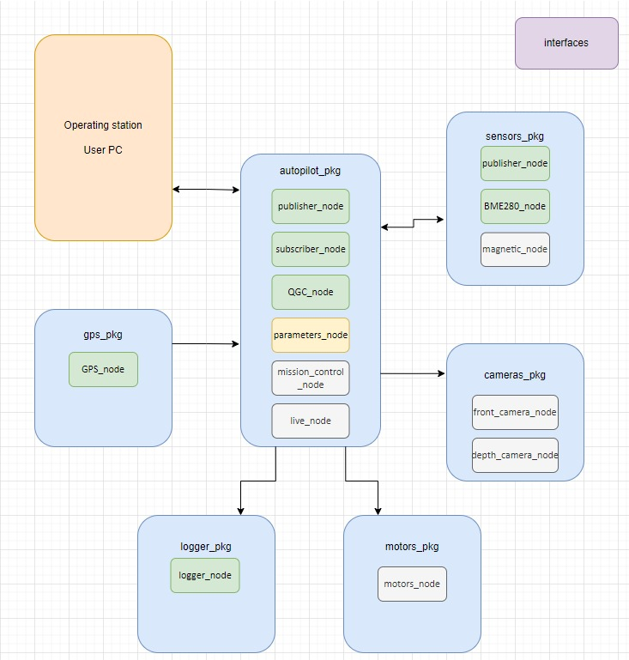
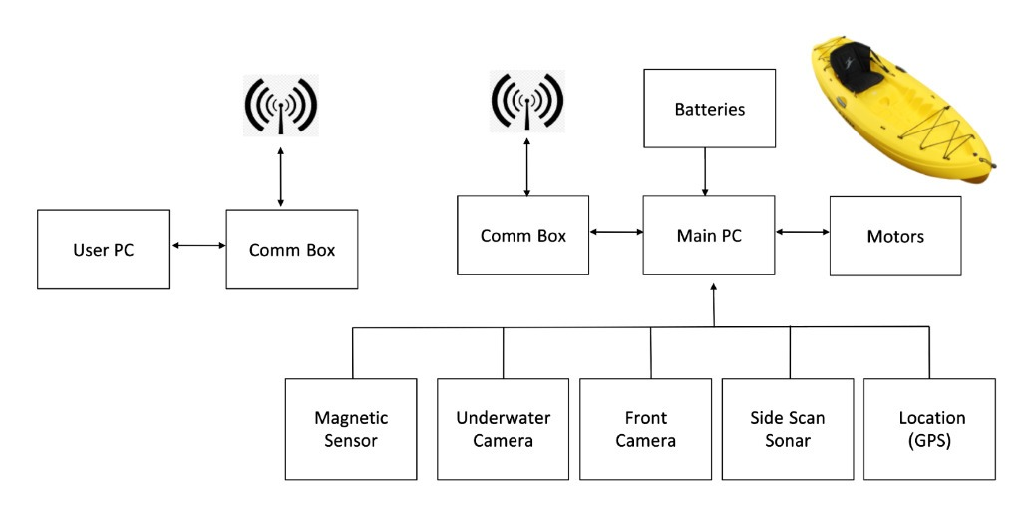
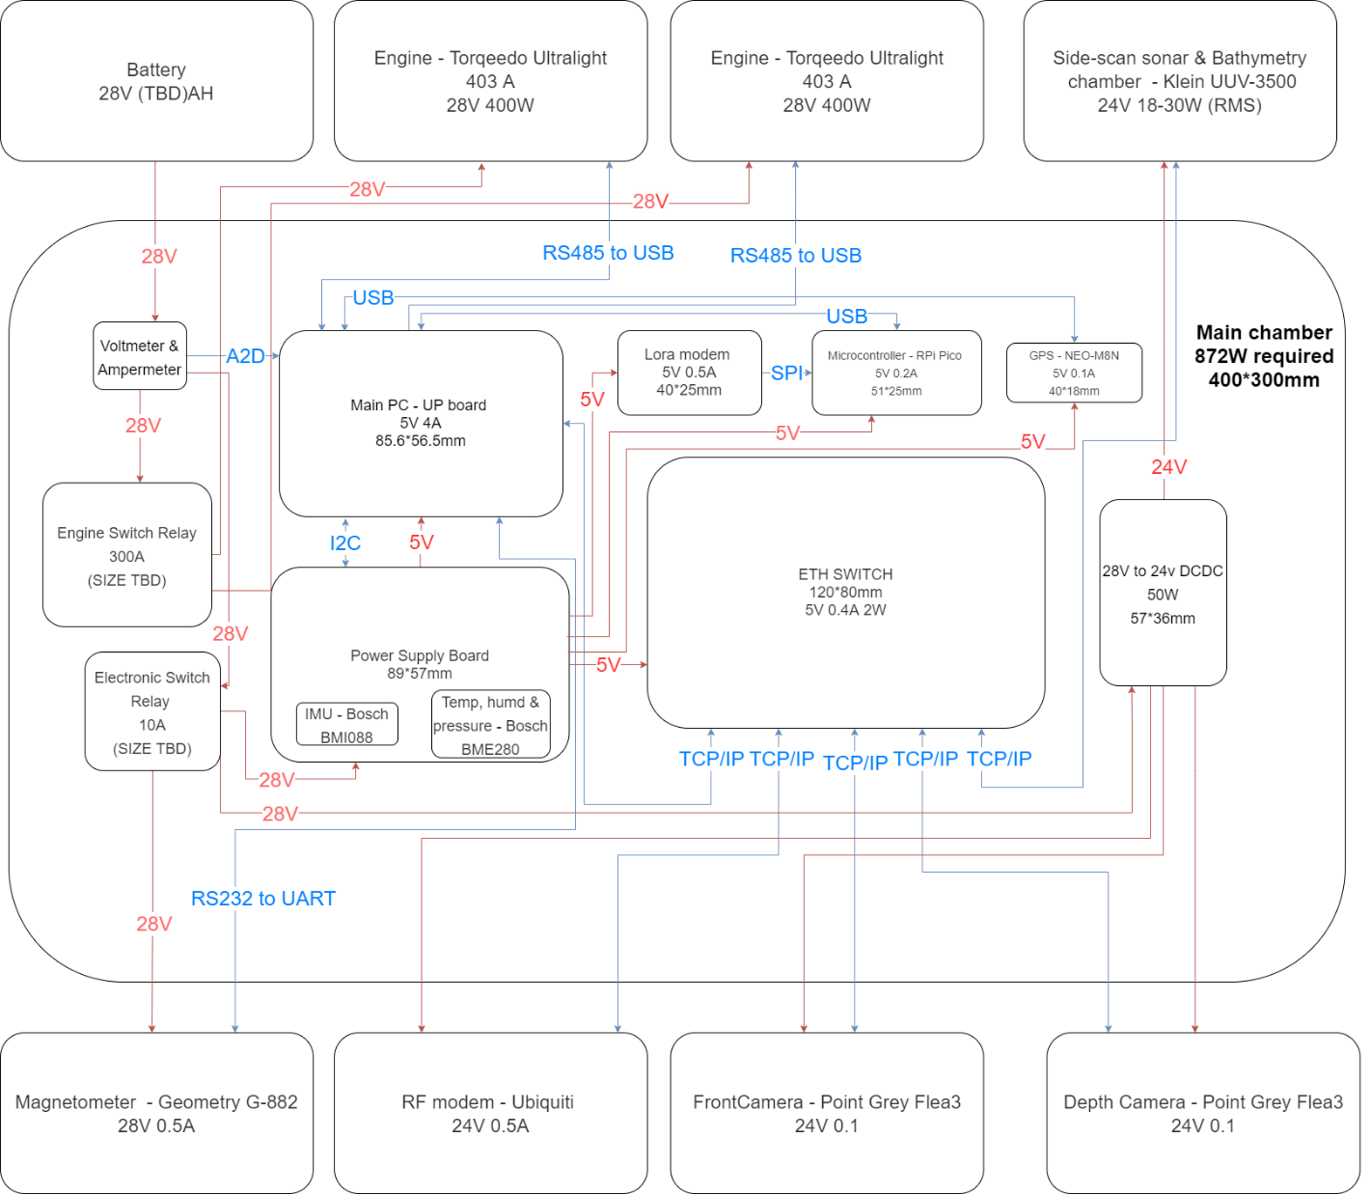
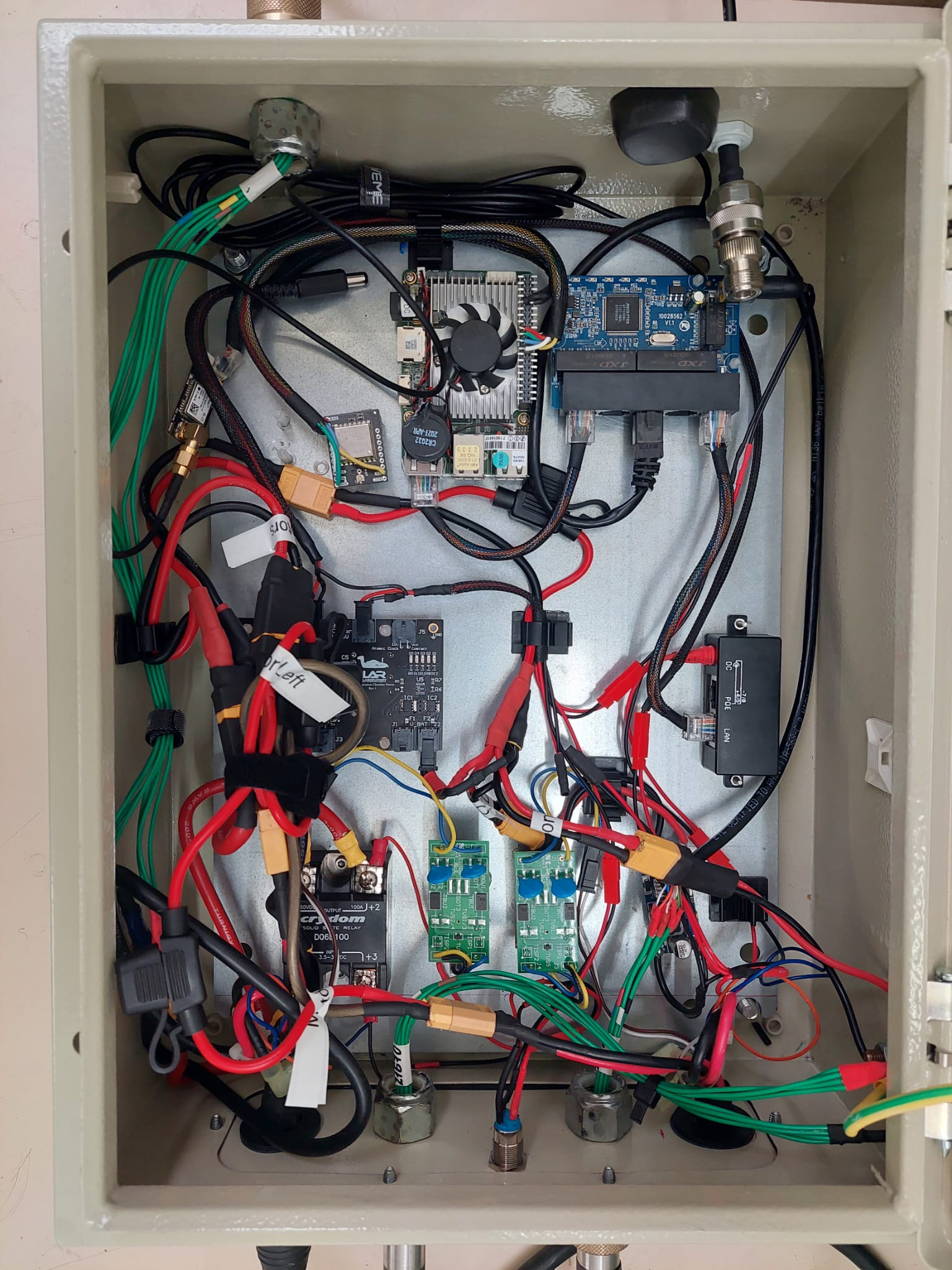
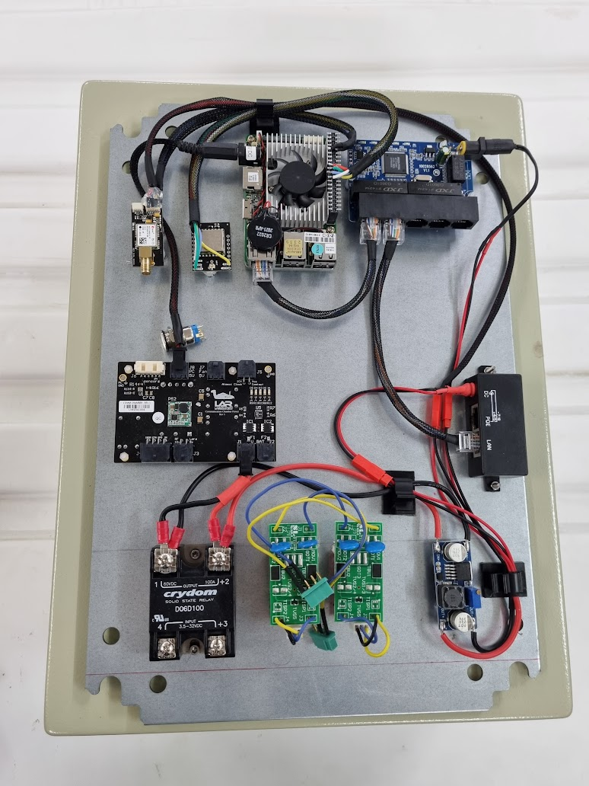
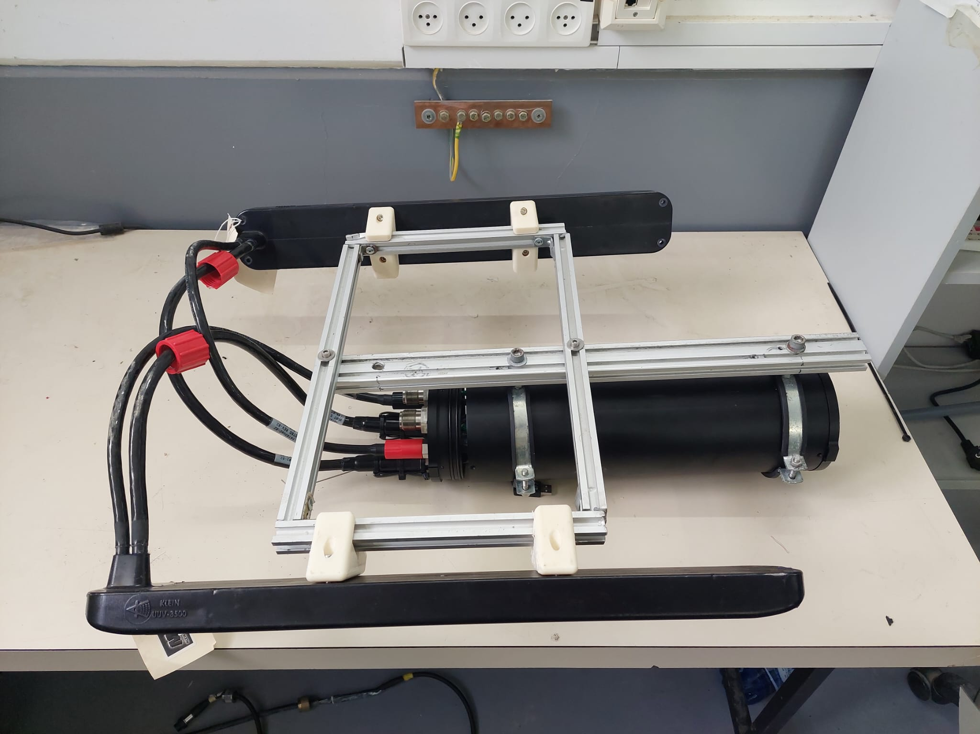
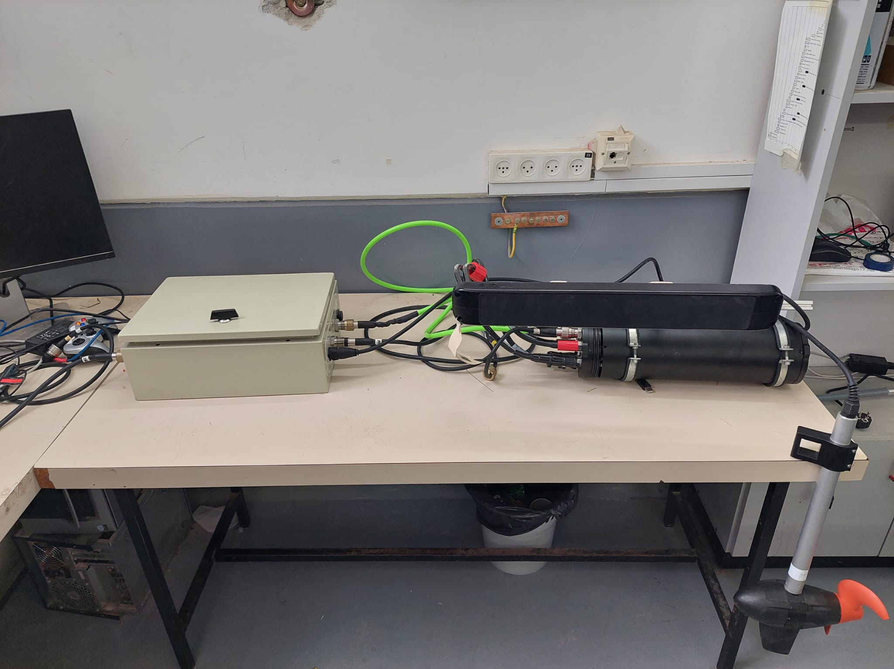
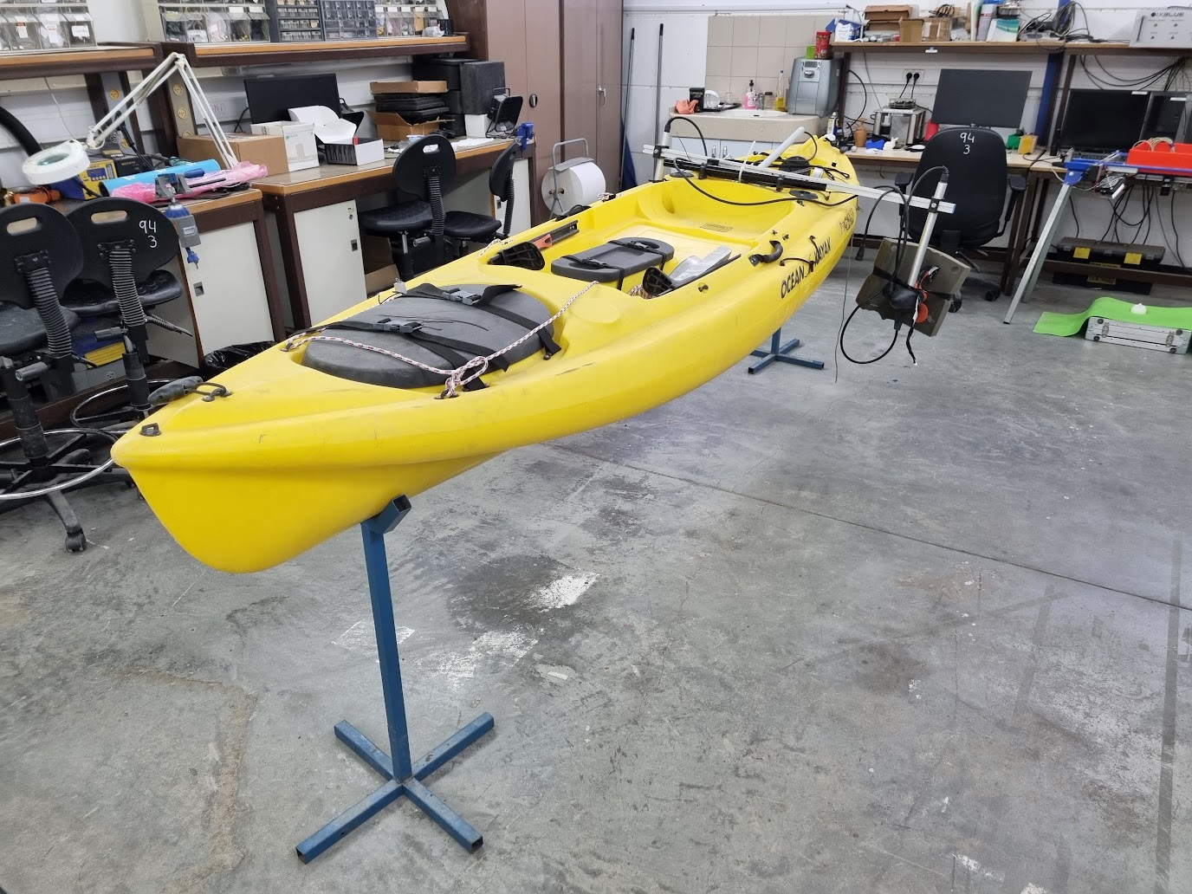

P-2023-115
Faculty of Engineering Sciences
School of Electrical & Computer Engineering
ASV for Real Time Searching and Survey
Yonatan Axelrad, Yuval Avigdor
Advisors: Prof. Hugo Guterman
1. Introduction
5. Software implementation on ROS2 framework
And autonomous surface vehicle (ASV) developed for surveying shallow water reservoirs such as small lakes, drinking water reservoirs, fish reservoirs, and more. These bodies of water are categorized by varying water clarity, depths and many times contain third party interferences such as pumps or nets.
ASV main features:
A suite of sensors that provides real-time information of the water floor.
A system easy to deploy that can maneuver autonomously in shallow water reservoirs.
Real-time transmission of sensor data and telemetry to a remote control base.
The software was written in Python under the ROS2 (Robotic Operating System) framework, which handles all communication between the different modules needed for the platform.
ROS2 utilizes a hierarchy of packages and nodes. The main packages are:
Autopilot package:
Responsible for handling the logical and autonomous workings of the system.
GPS package: Receives GPS coordinates for navigation.
Motors package: A driver controlling the Torqeedo motors.
Sensors package: BME and BMI drivers for environmental sensing and Euler angles calculations for the navigation.
2. Basic block diagram of the system
3. Main electronics chamber design
The main electronics chamber contains all the electronic subsystems of the platform such as UP-board computer, power supply board, environmental sensors etc.
6. Results
Voltages and communications block diagram for main electronics chamber
Main electronics chamber’s hardware and mechanics is completed
ROS2 packages and modules are implemented and tested.
Motor communication and control driver is implemented and tested.
RF communication was tested up to 1Km.
Side scan sonar was successfully tested..
Q-Ground (GUI) was implemented and tested.
Full system assembly has been achieved
7. Conclusions and future work
4. Side sonar chamber mounting
Conclusions and Future work:
Due to delays in shipping and manufacturing, the system isn’t fully operational.
The ASV is functional and has begun testing.
Further work is necessary to:
Improve the autonomous navigation module.
Implement a ROS2 camera package.
Mount above and below surface cameras.
Develop a simulator for testing.
The Side-scan sonar is placed in a waterproof chamber. The sonar and the multi-beam transducers are mounted below the platform. Waterproof sea-cables connect the transducers to the sonar chamber, and the sonar chamber to the Electronics chamber on-board.
8. References
[1] S. Gan and X. Xiang, "Control system design of an autonomous surface vehicle," 2017 29th Chinese Control And Decision Conference (CCDC), 2017, pp. 495-499
[2] Stanford Artificial Intelligence Laboratory et al. Robotic Operating System [Internet]. 2018. Available from: https://www.ros.org
Notes:
1

